Slide 1

Optimal Protein Dosing:
Restrictive or Liberal?
Daren K. Heyland
Professor of Medicine
Queens University, Kingston General Hospital
Kingston, ON Canada

Slide 2


Note: Wide range of acceptability and
Low quality of evidence!

Slide 3

Optimal Protein Dose?

Slide 4
Conclusions
• In the context of energy restriction and good glycemic control, liberal protein supplementation remains an open question, particularly in nutritionally- high risk patients!
EFFORT Trial
• It is plausible that protein alone may be insufficient to effect the physical recovery of ICU patients- need anabolic stimulus from exercise and some pharmacological agents
The NEXIS Trial
Promote Trial

Slide 5
N Engl J Med 370;17
“clinically detected weakness in survivors of critical illness where there is no other cause noted except critical illness”
Both neuro and myo pathic process
Develops in 25%-100% of patients, higher in patient who have organ failure and prolonged mechanical ventilation
Considerable associated excess morbidity, mortality, and costs*
*AJRCCM Published on 13-May-2014

Slide 6
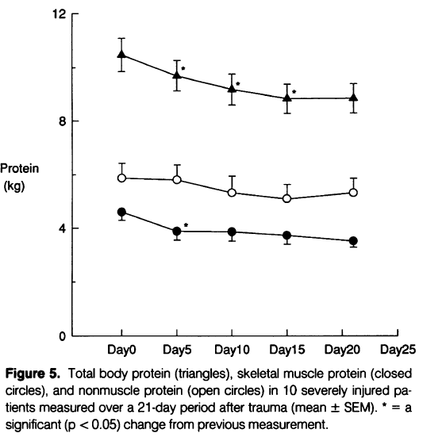
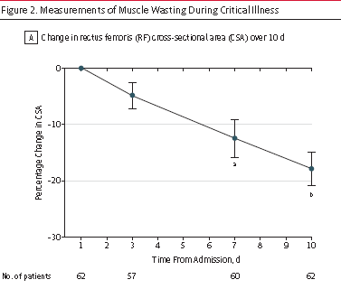
Critically ill Patient Lose Muscle Mass
Loss of skeletal muscle protein = loss of function
Monk DN, et al. Annals of surgery 1996; 223:395-405.
Puthecheary, JAMA, 2013

Slide 7
Does increasing protein delivery impact outcomes?

Slide 8
What happens to exogenously administered
amino acid?
Olav Rooyakers CC. icu-metabolism.se

Slide 9
Effect on Nitrogen Balance?
249 trauma patients receiving nutrition support
Dickerson J Trauma Acute Care Surg 2012

Slide 10
What is the evidence that exogenously administered amino acids/protein favorably impacts muscle mass and function?
RCT of 119 ICU patients requiring PN
Randomized to 0.8 gram/kg/day vs. 1.2 grams/kg/day IV aa
Ferrie JPEN 2016

Slide 11
What is the evidence that exogenously administered amino acids/protein favorably impacts muscle mass and function?
No impact on LOS or mortality
Ferrie JPEN 2016

Slide 12
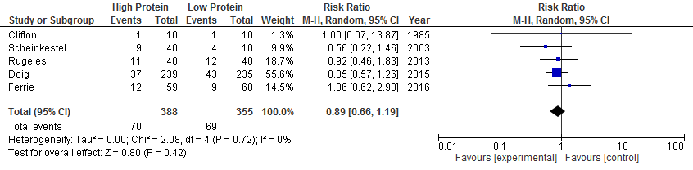
Systematic Review of RCTs of
High vs. Low Dose Protein

Slide 13
What is the evidence that exogenously administered amino acids/protein favorably impacts clinical outcomes?

Slide 14
Impact of Protein Intake on 60-day Mortality
Data from 2828 patients from 2013 International Nutrition Survey
 | Patients in ICU ≥ 4 d
Variable | 60-Day Mortality, Odds Ratio (95% CI)
 |  | Adjusted¹ | Adjusted²
Protein Intake (Delivery > 80% of prescribed vs. < 80%) |  | 0.61 (0.47, 0.818) | 0.66 (0.50, 0.88)
Energy Intake (Delivery > 80% vs. < 80% of Prescribed) |  | 0.71 (0.56, 0.89) | 0.88 (0.70, 1.11)
¹ Adjusted for BMI, Gender, Admission Type, Age, Evaluable Days, APACHE II Score, SOFA Score
² Adjusted for all in model 1 plus for calories and protein
Nicolo JPEN 2015

Slide 15
Rate of Mortality Relative to
Adequacy of Protein and Energy Intake Delivered
Current practice
0.7 gm/kg
Minimally acceptable
1.2 gm/kg
Ideal practice?
>1.5 gm/kg
Heyland JPEN 2015

Slide 16
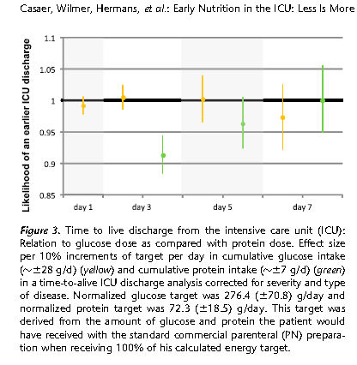
Early Nutrition in the ICU: Less is more!
Post-hoc analysis of EPANIC
Indication bias:
1) patients with longer projected stay would have been fed more aggressively; hence more protein/calories is associated with longer lengths of stay.
2) 90% of these patients are elective surgery. there would have been little effort to feed them and they would have categorically different outcomes than the longer stay patients in which their were efforts to feed
Protein is the bad guy!!
Casaer Am J Respir Crit Care Med 2013;187:247–255

Slide 17
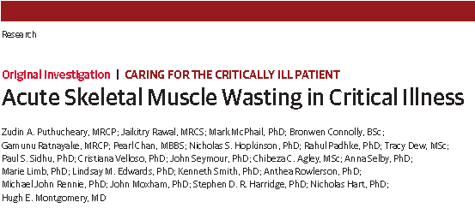
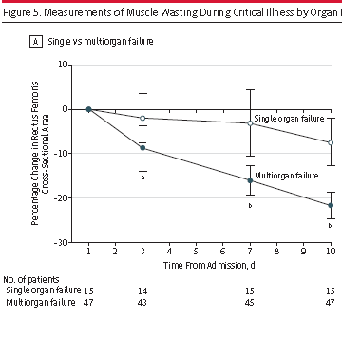
JAMA Published online Oct 9, 2013

Slide 18
“In a multivariable linear analysis, change in rectus femoris CSA was positively associated with the degree of organ failure, CRP level and amount of protein delivered”
JAMA Published online Oct 9, 2013

Slide 19
78 patient with ALI randomized to Intensive Medical therapy (30 kcal/kg/day) or usual care (40-60% of target)
Stopped early because of excess deaths in intensive group
Post hoc analysis suggests increased death from early protein!

Slide 20
Optimal Dose of Protein/AA?

Slide 21
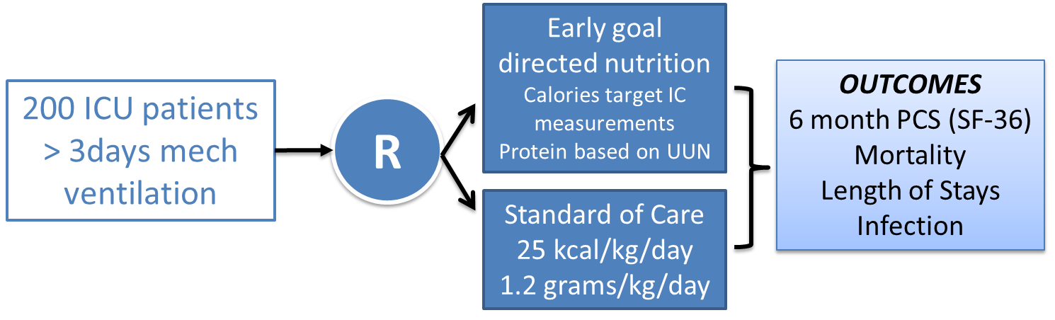

Slide 23
Wide confidence intervals; MCID 2-4
Poor glycemic
control

Slide 24
Critique of EAT-ICU
• ? Validity
-unblinded (outcome assessors were blinded)
-underpowered
-choice of primary outcome (PCS may not be responsive to nutritional intervention)
-glucose control confounds interpretation
Generalizability
  -single center
  -poor glycemic control
  -unselected or heterogeneous nutrition risk profiles
  Interpretation?
Notes:
Those ideas are…

Slide 25
Critique of EAT-ICU
• Interpretation?
• No direct measure of protein balance
No measure of body composition
No measure of muscle function
Notes:
Those ideas are…

Slide 26
Is it still plausible that ‘more protein’, when controlling for energy intake and adequate glycemic control, still results in improved outcomes?

Slide 27
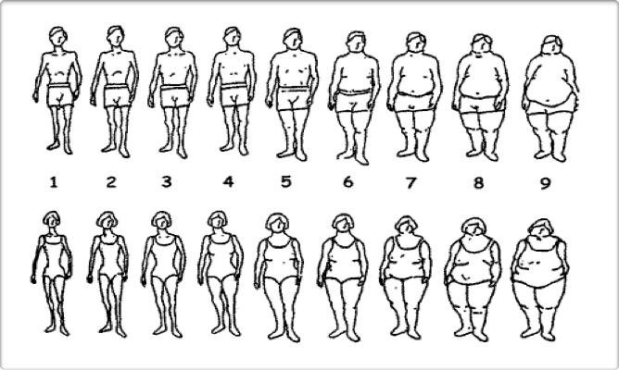
ICU Patients Are Not All Created Equal…
Should We Expect the Impact of Nutrition Therapy to be the Same Across All Patients?
Notes:
Need to study more homogenoous patient populations that are in some way take into consideration of their underlying risk

Slide 28
A Conceptual Model for Nutrition Risk Assessment in the Critically Ill
Acute
Reduced po intake
pre ICU hospital stay
Chronic
Recent weight loss
BMI?
Starvation
Nutrition Status
micronutrient levels - immune markers - muscle mass
Inflammation
Acute
IL-6
CRP
PCT
Chronic
Comorbid illness

Slide 29
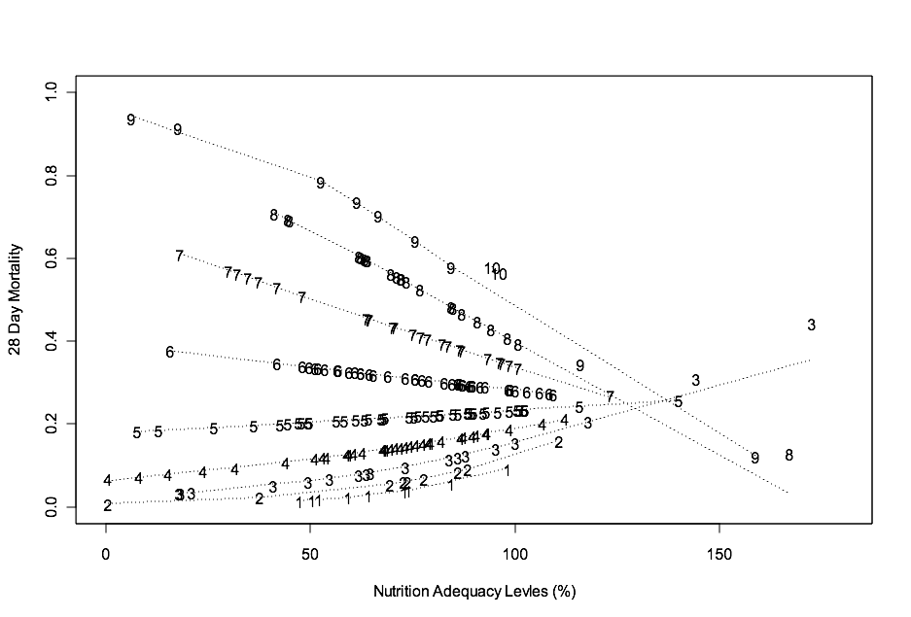
The Validation of the NUTrition Risk in the Critically Ill Score (NUTRIC Score)
Interaction between NUTRIC Score and nutritional adequacy (n=211)*
Heyland
Critical Care 2011, 15:R28

Slide 30
The Validation of the NUTrition Risk in the Critically Ill Score (NUTRIC Score)
Validated in 3 separate databases including the INS Dataset involving over 200 ICU’s worldwide ^{1,2,3}
Validated without IL-6 levels (modified NUTRIC) ²
Independently validated in Brazilian, Portuguese, and Asian populations ^{4,5,6,7}
Not validated in post hoc analysis of the PERMIT trial ⁸
– RCT of different caloric intake (protein more important)
– Underpowered, very wide confidence intervals
Heyland Critical Care 2011, 15:R28
Rahman, Clinical Nutrition 2013.
Compher, CCM, 2016 (in press)
Rosa, Marcadenti Clinical Nutrition ESPEN 2016
Mendes J Crit Care 2017
Mukhopadhyah Clinical Nutrition 2016
Lee Clin Nutrition 2017
Arabi AmJRCCM 2016

Slide 31
Validation of NUTRIC Score in Large International Database >2800 patients from >200 ICUs
Protein
Calories
^Faster time-to-discharge alive with more protein and calories ONLY in the high NUTRIC group
Compher C et al. Crit Care Med. 2017;45(2):156-163.

Slide 32

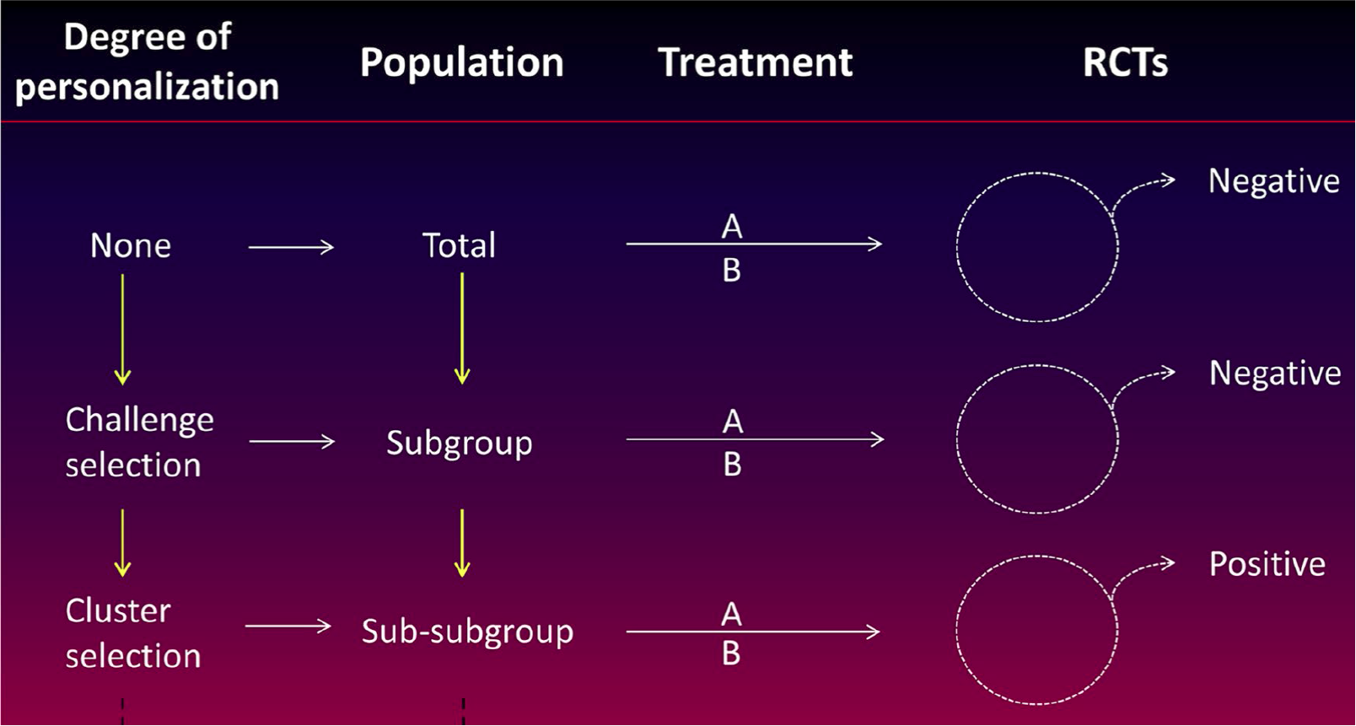
Move Towards Personalized Medicine …and away from large RCT’s of heterogeneous patients!
Intensive Care Med (2016)42:1781-1783

Slide 33
Results of TOP UP Pilot Trial
A RCT of supplemental PN in low and high BMI ICU patients
Post-hoc subgroup analysis
Wischmeyer Critical Care 2017’

Slide 34
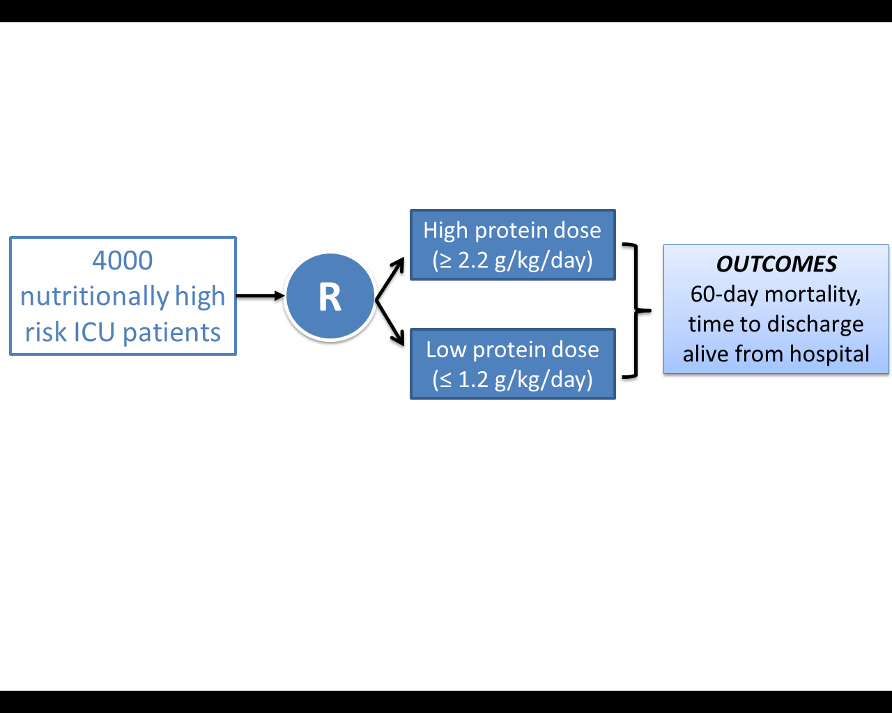
The Effect of Higher Protein Dosing
in Critically Ill Patients:
The EFFORT Trial
Target >2.2 gram/kg/day
Primary Outcome
4000 ICU patients
R
Stratified by:
Site
BMI
Med vs Surg
Fed enterally
60 day
mortality
Target <1.2 gram/kg/day
A multicentre, pragmatic, volunteer-driven, registry-based, randomized, clinical trial.
Notes:
Stop here for questions
.

Slide 35
Overall Hypothesis
Compared to the receiving lower dose of prescribed protein, the prescription of a higher dose of protein/amino acids to nutritionally high-risk critically ill patients will be associated with greater amount of protein delivered and result in improved survival and a quicker rate of recovery.

Slide 36
Study Population
MUST focus on ‘high nutritional risk’ patients.
One or more of the below risk factors:
  NUTRIC >5
  Low (≤ 25) and High BMI (≥ 35)
  Mod-Severe Malnutrition* (as diagnosed by local standards)
  Frailty (Clinical Frailty Scale 5 or more)
  Sarcopenic- (SARC-F score of 4 or more)
  Projected duration of mechanical ventilation >4 days
Difficult to collect ‘real-time’; will collect data and do subgroup analysis
*We will document the means by which sites are making this determination and capture the elements of the assessment (history of weight loss, history of reduced oral intake, etc.).

Slide 37
Study Population
Inclusion Criteria | Exclusion Criteria | Rationale for Exclusion
1. >18 years old 2. Nutritionally “high-risk” (meeting one of the below criteria) Low (<25) or High BMI (>35) Moderate to severe malnutrition (as defined by local assessments) Frailty (Clinical Frailty Scale, 5 or more from proxy) Sarcopenia – (SARC-F score of 4 or more from proxy) From point of screening, projected duration of mechanical ventilation >4 days) 3. Requiring mechanical ventilation with actual or expected total duration of mechanical ventilation >48 hours | >96 continuous hours of mechanical ventilation before screening | Intervention is likely most effective when delivered early
 | 2. Expected death or withdrawal of life-sustaining treatments within 7 days from screening | Patients unlikely to receive benefit
 | 3. Pregnant | Unknown effects on fetus
 | 4. The responsible clinician feels that the patient either needs low or high protein | Uncertainty doesn’t exist; patient safety issues
 | 5. Patient requires parenteral nutrition only and site does not have products to reach the high protein dose group. | Site will be unable to reach high protein dose prescription.

Slide 38
For more information on EFFORT Trial
See www.criticalcarenutrition.com
Or contact:
Daren K. Heyland
Professor of Medicine
Queens University, Kingston General Hospital
Kingston, ON Canada
dkh2@queensu.ca

Slide 39
So far, what have I said?
• In the context of energy restriction and good glycemic control, liberal protein supplementation remains an open question, particularly in nutritionally- high risk patients!
EFFORT Trial
• It is plausible that protein alone may be insufficient to effect the physical recovery of ICU patients- need anabolic stimulus from exercise and some pharmacological agents
The NEXIS Trial
Promote Trial

Slide 40
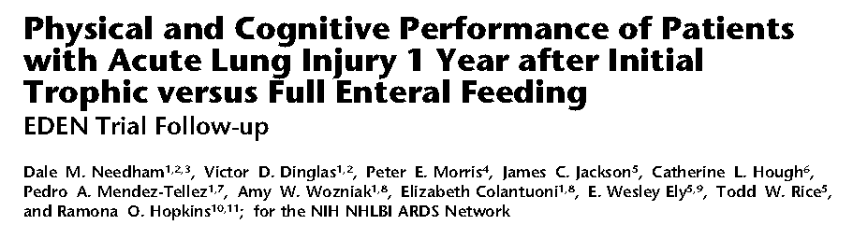
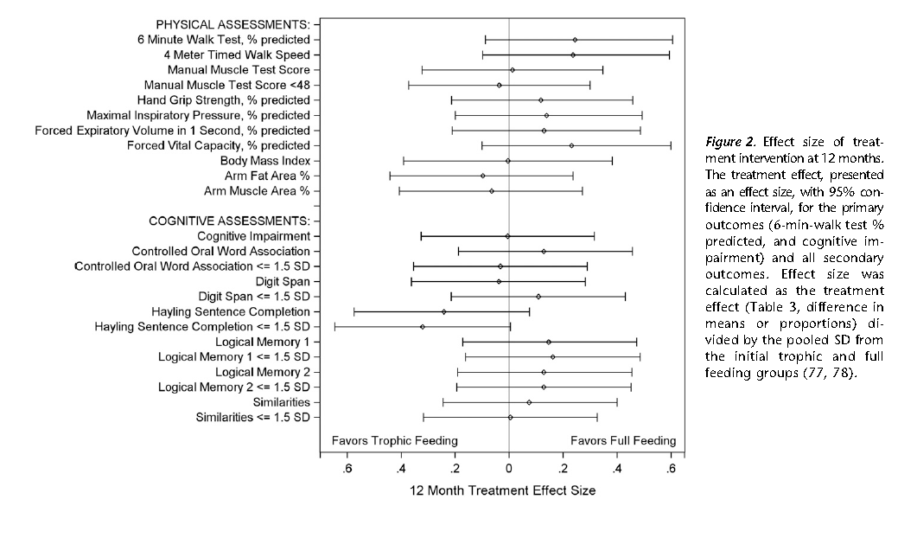

Slide 41
Nutritional Adequacy and Long-term Outcomes in Critically Ill Patients Requiring Prolonged Mechanical Ventilation
Sub study of the REDOXS study
302 patients survived to 6-months follow-up and were mechanically ventilated for more than eight days in the intensive care unit were included.
Nutritional adequacy was obtained from the average proportion of prescribed calories received during the first eight days of mechanical ventilation in the ICU.
HRQoL was prospectively assessed using Short-Form 36 Health Survey (SF-36) questionnaire at three-months and six-months post ICU admission.
Wei CCM 2015

Slide 42
Estimates of association between nutritional adequacy and SF-36 scores
*Every 25% increase in nutritional adequacy; adjusted for age, APACHE II score, baseline SOFA, Functional Comorbidity Index, admission category, primary ICU diagnosis, body mass index, and region

Slide 43
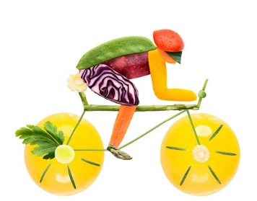
How to get bigger bang for your buck!
Combination of Nutrition and exercise!

Slide 44

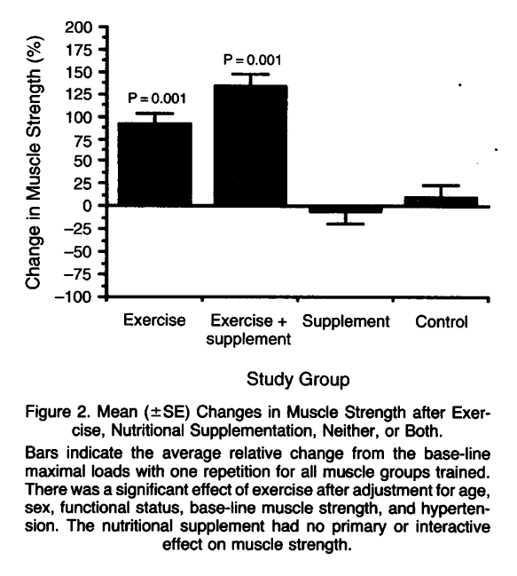
Exercise Training and Nutritional Supplementation for Physical Frailty in Very Elderly People
Fiatarone, NEJM 1994;330:1769-1775.
Notes:
As we think about the physical recovery of our patients… evidence that it is the combination of ….. But what do you as dietitians know about activity/exercise? What do you our rehabilitation partners know about nutrition.

Slide 45
This systematic review summarizes the effect of combined exercise and nutrition intervention on muscle mass and muscle function.
A total of 37 RCTs were identified.
Results indicate that physical exercise has a positive impact on muscle mass and muscle function in subjects aged 65 years and older.
However, any interactive effect of dietary supplementation may be modest

Slide 46
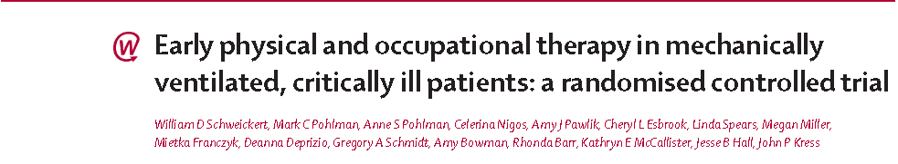
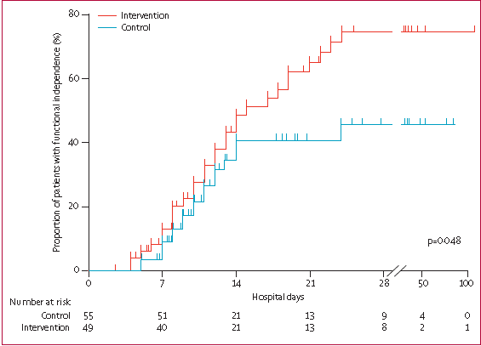

Lancet 2009;273:

Slide 47



The NEXIS Study
(Nutrition and EXercise Interventional Study in critically ill patients)
Bedside cycling ergometry
and IV amino acids
(2-2.5 grams/kg/day)
Primary Outcome
6 min WD
142 ICU patients
Projected length of
stay >3 days
R
Concealed Stratified by
Site
Secondary Outcome
HRQOL
ADL/IADL
Muscle strength
Fed enterally
Usual Care
(bed rest and underfeeding)
In collaboration with Renee Stapleton and Dale Needham
Funded by NIH

Slide 48
Ulimorelin is an IV Ghrelin Agonist with Multiple Potential Benefits in EFI Patients
Ghrelin is a potent stimulant of GI motility and Lean body mass deposition
A ghrelin-based therapeutic could have positive effects in the critical care setting
  Pro-motility: improving gastric emptying and enabling protein and calorie administration by enteral route
  Pro-anabolic: increasing growth hormone and IGF-1levels and driving LBM deposition
  Anti-catabolic: reducing systemic inflammation and inflammation-mediated muscle catabolism
Ghrelin agonists have been shown to
  Promote LBM, physical performance, and breathing capacity in chronic lung pts
  Increase LBM in cancer cachexia
  Accelerate gastric emptying in pts with GI motility disorders
Camilleri 2009, Kajimi 2008, Pradhan 2013,, Kojima 1999, Jacobs 2010, Cheyuo 2012, Nagaya 2005, Levinson 2012, Temel 2016, Shin 2013, Acosta 2015

Slide 49
Effects of Ghrelin on Muscle Function in COPD Patients
Hand-grip strength
Maximal Inspiratory Pressure
40
100
P < 0.05
P < 0.05
30
80
cm H₂O
60
kg
20
40
10
20
0
0
Before
After
Before
After
Nagaya 2005

Slide 50
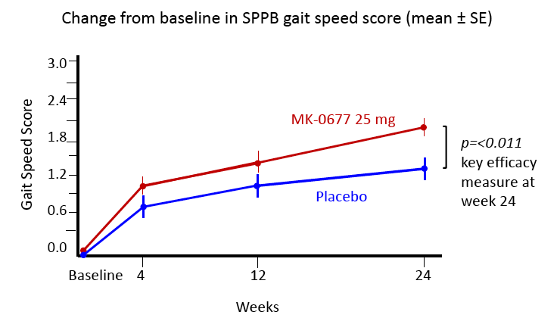
Oral Ghrelin Agonist MK-677 (Ibutamoren) Improves SPPB Gait Speed in Older Adults Post Hip Fracture
SPPB: Short Physical Performance Battery
Adunsky 2011

Slide 51
Phase 2, Multicenter, Randomized, Double-Blind, Comparator-Controlled Study of the Intravenous Ulimorelin (LP101) in Patients with Enteral Feeding Intolerance (EFI): The PROMOTE Study
ulimorelin 600 µg/kg IV infusion Q8H for 5 days
OUTCOMES
Protein received through enteral nutrition as a percentage of the patient’s target daily protein
120
ICU patients
With EFI
(GRV>500 ml)
R
metoclopramide 10mg Q8H for 5 days

Slide 52

Evaluation Framework for Interventional Studies Designed to Aid in the Recovery of ICU Patients
Baseline Status
Including Physiology, Function, Disability, and Quality of Life
Should be Assessed with Tools that Parallel those to be used after Acute Illness
Acute
Illness
Interventions
Pathology and Impairment during illness
Assessment of structure and Function in ICU:
e.g. Protein balance, muscle mass, biopsy, nerve conduction studies, etc.
Activity Limitations Following Illness
Assess Activities in a Standardized Research Environment (Prior to hospital discharge)
e.g. 6 MWD, TUG, grip strength, etc.
Participation Restriction
Assess Participation in Usual Environment (following hospital discharge) e.g. SF-36 Physical Function domain, IADL, ADL, etc.
Quality of LIfe
Assess Holistic QOL in Usual Environment (6-12 months later) : e.g. EQ-5D, SF-36, etc.
Heyland Clin Nutr 2015

Slide 53
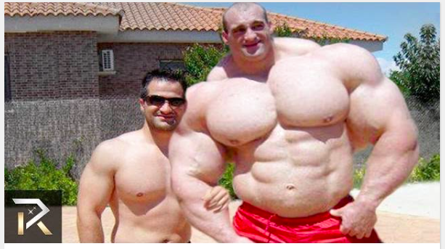
Liberal Protein, Exercise and anabolic agents!
Former ICU Survivors

Slide 54
To Determine the Optimal Dose of Protein
• More large, multicenter trials needed
Focus on high nutritional risk patients (EFFORT)
• Consider more relevant patient reported-outcomes and functional assessments
Combining with exercise or other pharmacological strategies that promote anabolism
will increase treatment effect (NEXIS, PROMOTE)

